Slide 1
Intellectual property rights
Product Design @ Fortrose Academy

Slide 2
What is Intellectual Property?
It is to do with who owns knowledge/ ideas/ technology/ designs.

Slide 3
Different Types of IPR
Confidentiality
Copyright ©
Patent
Trademark ™
Brand
Design Rights
Registered Design ®

Slide 4
What do I need to know about for my exam?
Patent
Trademark ™
Brand
Design Rights
Registered Design ®

Slide 5
Patent
You will have heard about Patents on Dragon’s Den.
Consist of a set of exclusive rights granted to an inventor for a limited period of time, in exchange for the public disclosure of the invention
They cover: technology, gadgets, mechanisms, new products
They have to be applied for to the Patent Office
They can be sold

Slide 6
Design Right
Covers new versions of an existing product which looks different or functions differently.
Design Rights last for 10 years.

Slide 7
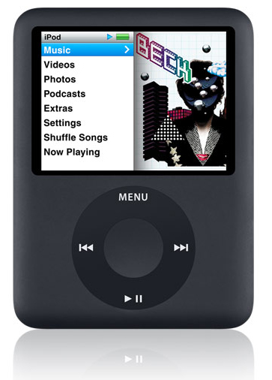
Registered Design
Covers the appearance/style of a particular type of product
E.g. Volkswagen Bettle, Anglepoise Lamp, iPod
Lasts 25 years

Slide 8
Brand
What you associate with a company i.e. quality, cost, reliability, status
Symbols?
Companies take years and a lot of advertising to build up their ‘Brand Image’. They get VERY upset if someone tries to copy their trademarks etc

Slide 9
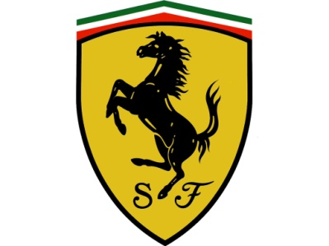
Trademark ™
Purely visual
Logo, brand image. Helps people to recognise a Brand.
Has to be registered at the patent office

Slide 10
What do I write in the exam though? ☹
With regards to a designer:
Ideas are the Intellectual Property (IP) of the creator, either of an individual or a company
Designer must ensure that they are not infringing other patents etc.
Original design drawings must be kept safe as proof.
An in-house designer has no rights to the design, all rights lie with his/her employer
A freelance or consultant designer may be able to protect his design by use of a patent.

Slide 11
What do I write in the exam though? ☹
With regards to client/manufacturer:
Will protect them by the use of patents and/or trademarks but as patents are in the public domain these ideas may be copied by other companies in other parts of the world.
Creative processes which generate new ideas may have commercial value
Commercially valuable ideas can be at risk if not carefully protected, and others may gain commercial advantage as a result
IP can have enormous commercial value and can be traded as a commodity

